Slide 1
PROJECT 1
Healthcare and Insurance and GDP Relations
(Lucas, Shaun, Matthew, and Paul)

Slide 2
BACKGROUND: WHAT IS FEE FOR SERVICE (FFS)?
“Fee-for-service is a system of health insurance payment in which a doctor or other health care provider is paid a fee for each particular service rendered, essentially rewarding medical providers for volume and quantity of services provided, regardless of the outcome.” -healthinsurance.org
The negative effects of FFS negatively affects lower to middle income communities the most, since there is no emphasis on patient outcome.
This also encourages the use of sketchy medical practices and may lead to inadequate care.
This practice is trying to be slowly phased out, in favor of Value Based Care.
Sources:
https://www.ncbi.nlm.nih.gov/pmc/articles/PMC4322626/
https://www.healthinsurance.org/glossary/fee-for-service/

Slide 3
WHAT ARE WE TRYING TO VISUALIZE?
We are analyzing Medicare Fee For Service Data to see where Fee for Service providers target, and how they operate.
We will look at one county in each of the 11 congressional districts in Virginia and compare them based on the FFS services provided, FFS payments per county, income per capita, and population. This will give us insight into how FFS operates and who it affects the most.
This will potentially help us visualize disparities within our own state regarding health care and income. We will use data visualization to show our findings. Our hypothesis is that we will find a lesser amount of FFS health care providers in lower income counties.
We think we will also see this trend in rural areas as opposed to metro areas. We suspect the correlation of Fee-For-Service and lower income areas to be a high.
We are combining data from FRED (Federal Reserve Economic Data) and

Slide 4
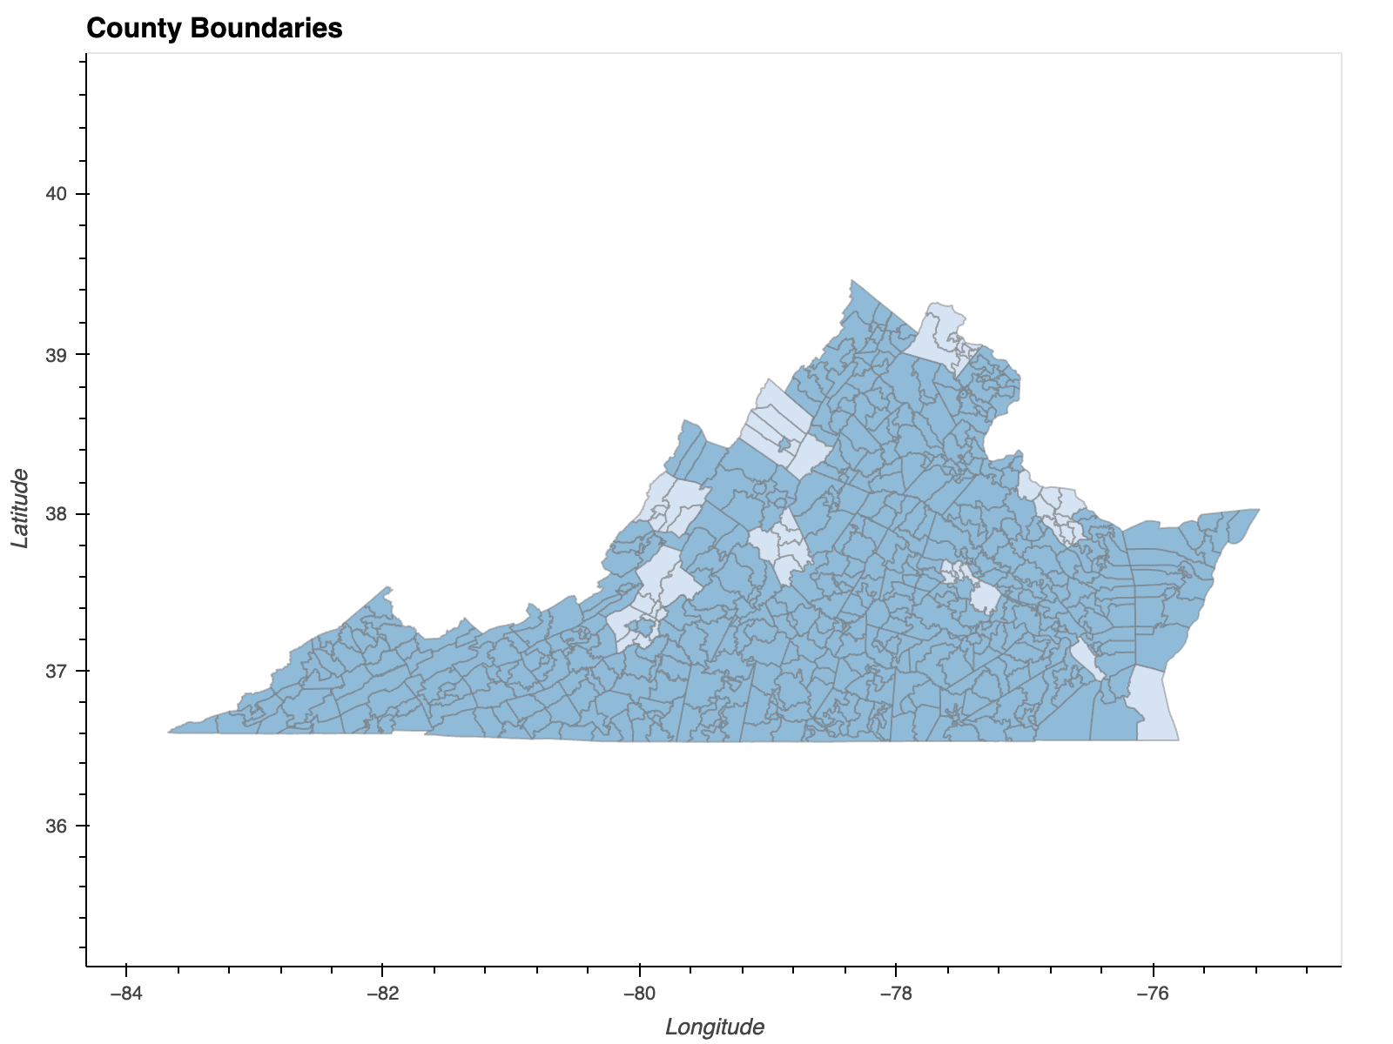
COUNTIES USED FOR DATA SETS

Slide 5
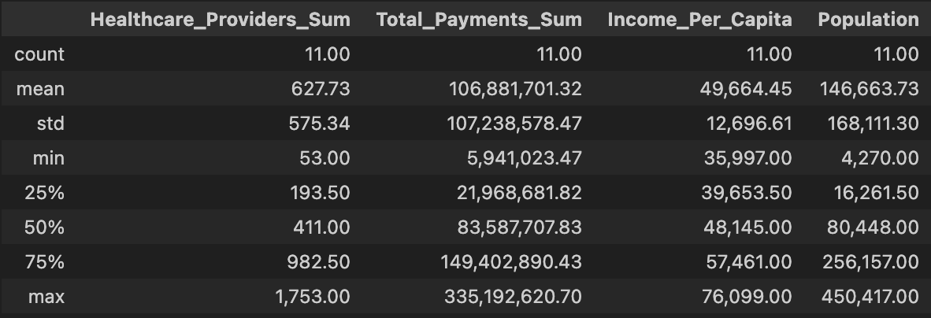
SUMMARY STATISTICS
- Here we can see summary statistics for the main variables we are interested in.
- We can see that the spread of Healthcare Providers, Total Payments, and populations is very large when compared to income per capita. Especially since their standard deviations are so large compared to their means. This could be a sign that income per capita is not the only thing related to FFS activity.
- Healthcare Providers and Total Payments are also skewed towards larger numbers. This could mean that most of our FFS activity is coming from a handful of counties.

Slide 6
WHICH TYPES OF FFS HEALTH SERVICES ARE MOST USED YEAR BY YEAR?
2015-2018

Slide 7
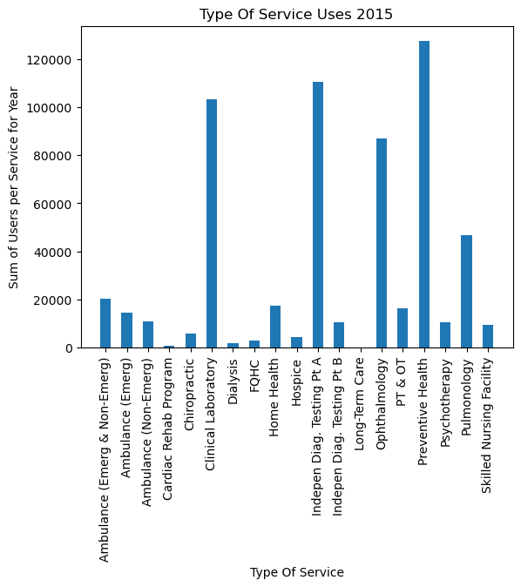
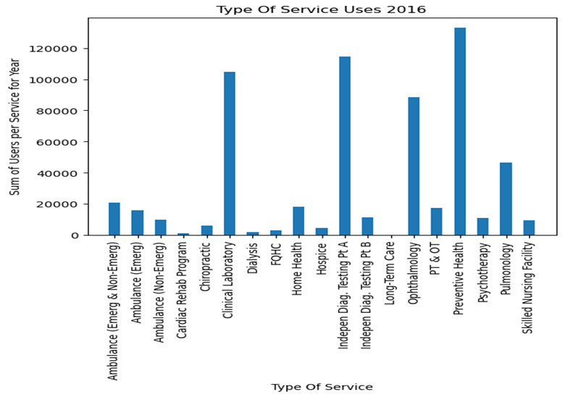
TYPE OF SERVICE USED 2015-2018

Slide 8
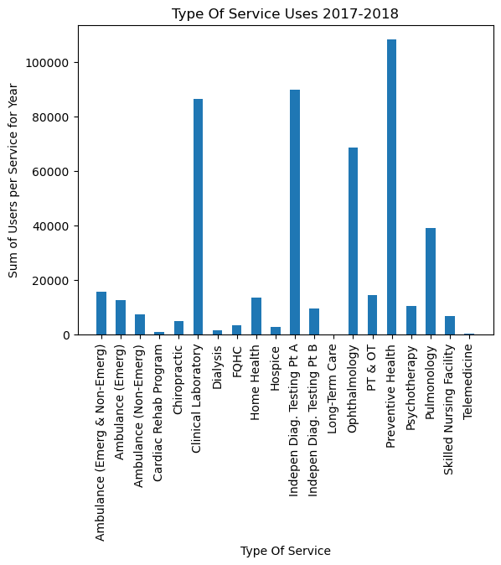

Slide 9
WHAT DOES THIS MEAN?
Prevention Health, Independent Diagnostics, and Clinical Health take the top 3 spots for each year.
The top categories are consistent and rarely changes year to year
In 2018 we see a small addition to our data, which is a column for Telemedicine.
Independent Diagnostics are the 3rd most popular service and are known for cutting corners and not meeting regulatory standards. They operate outside the mainstream medical system. -Office of the US Inspector General
This could be indicative of FFS providing inadequate services to these areas

Slide 10
CAN WE FIND DIFFERENCES IN FFS PAYMENTS ACROSS YEARS AND COUNTIES?

Slide 11
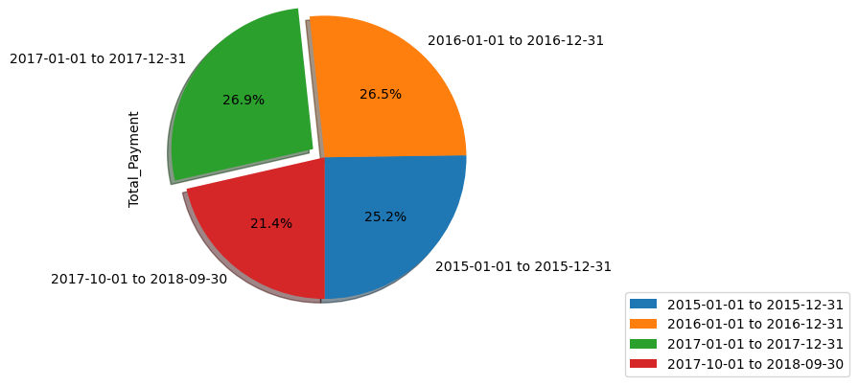
TOTAL PAYMENTS FOR EACH YEAR

Slide 12
WHAT DOES THIS MEAN?
In 2018, there was a notable drop in the amount of total payments. This could mean that FFS services may be on the decline in these Virginia counties.
Unfortunately, this dataset is limited through September 2018 so further research is needed to tell why we see the drop.
This begs the follow-up question: Which counties had the highest amount of payments? What about when we compare them to income per capita and population? What trends can we see?

Slide 13
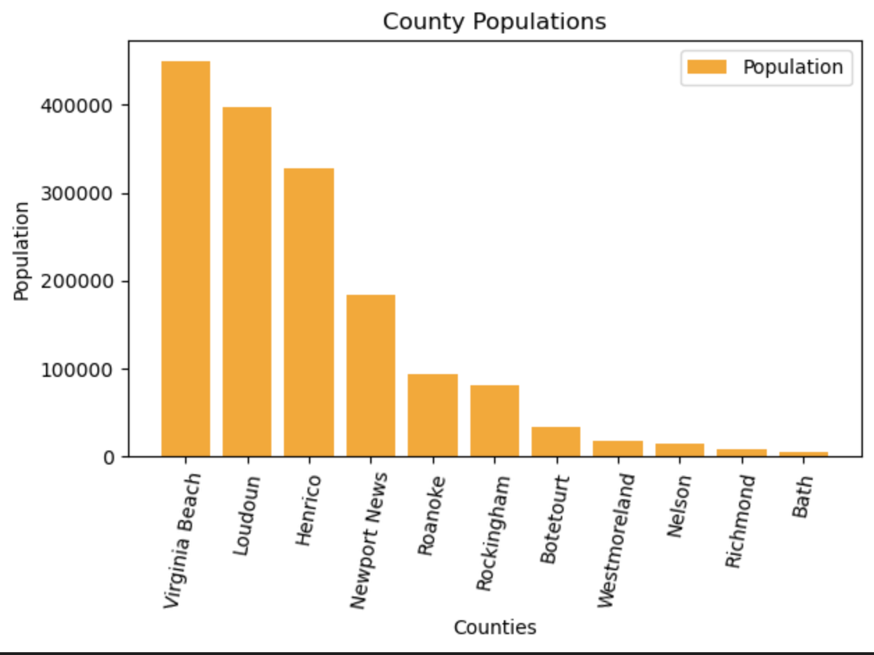
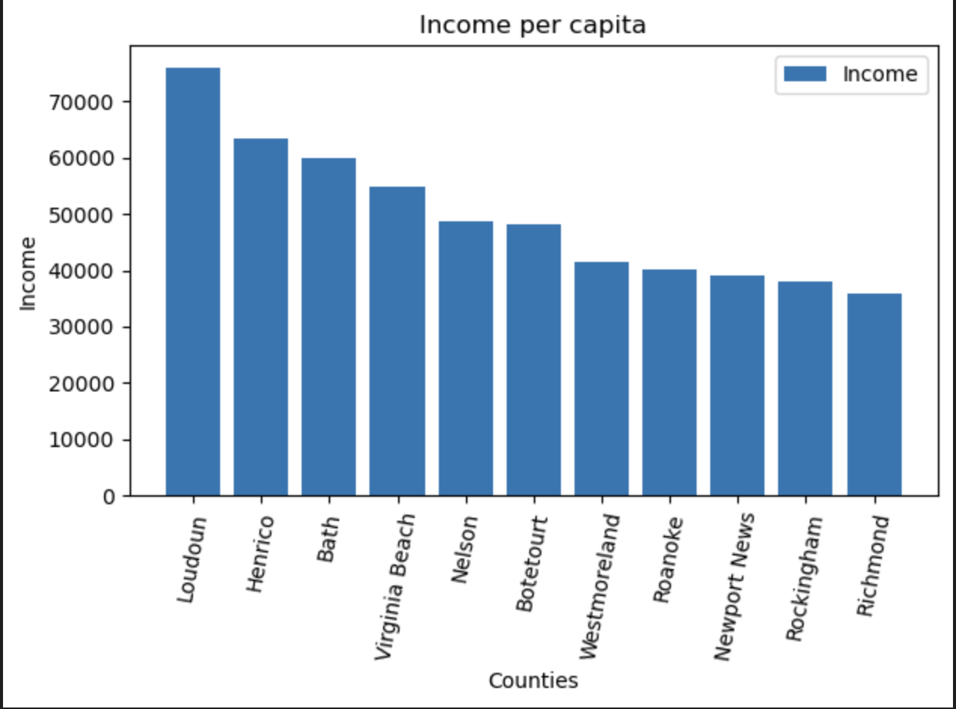
Bar Graph for Population and Income per capita by county
*Similar population sizes
*Loudoun income much greater.

Slide 14
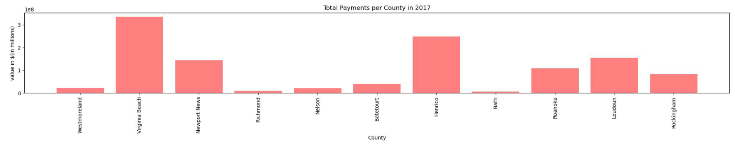
BAR GRAPH FOR PAYMENTS IN EACH COUNTY IN 2017
*Virginia Beach has more total payments than Loudoun

Slide 15
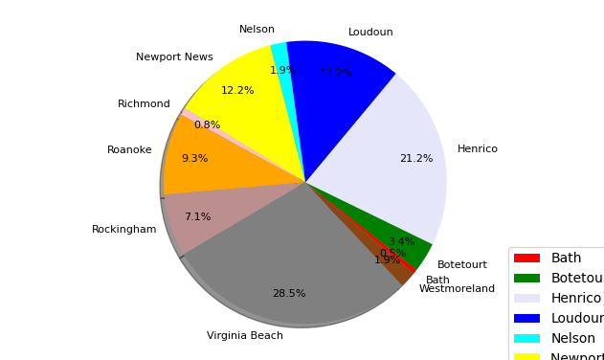
TOTAL PAYMENTS FOR EACH COUNTY IN 2017
*Top three counties for total payments are Virginia Beach, Henrico, and Loudoun

Slide 16
WHAT DOES THIS MEAN?
The pie chart and bar graph for the FFS payments shows that our data has a high amount of variance between the counties with the highest amount of FFS payments and the lowest.
Virginia Beach, Loudoun, and Henrico county are the top FFS payers with Virginia Beach having the largest amount with around $350 million.
These are also the counties with the top three populations as shown in the population bar graph.
Virginia Beach has the highest total FFS payments but a lower Income per capita than Loudon ($75k vs $55k), even though it has a similar population to Loudoun.
This further points to population being an additional factor for FFS services being used more.
Could this be indicative of FFSs targeting lower income populations?

Slide 17
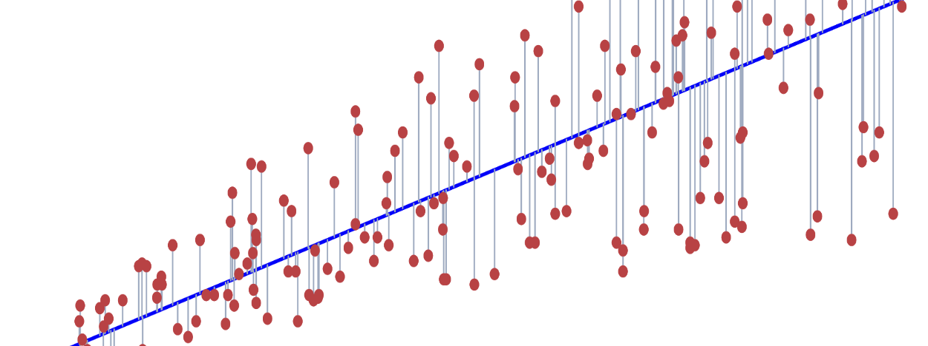
LINEAR REGRESSION, NULL HYPOTHESIS & T-TEST

Slide 18

HYPOTHESIS:
If/Then = IF Income per capita (GDP) of a county is related to the amount of medicare FFS Payments in a given county, THEN as Income per Capita decreases, the number of FFS payments should increase since medicare FFS services target lower income populations.
Null = The Income per capita and the FFS payments will have no correlation between them.
Alternative = The lower the Income per capita the higher the FFS usage, and the higher the income per capita the lower the FFS usage will be.

Slide 19

Independent T-TEST
The p-value is less than .5 which means that we reject the null hypothesis. There is definitely a correlation between income per capita and the FFS health care payments across these Virginia counties. Is our hypothesis correct?

Slide 20
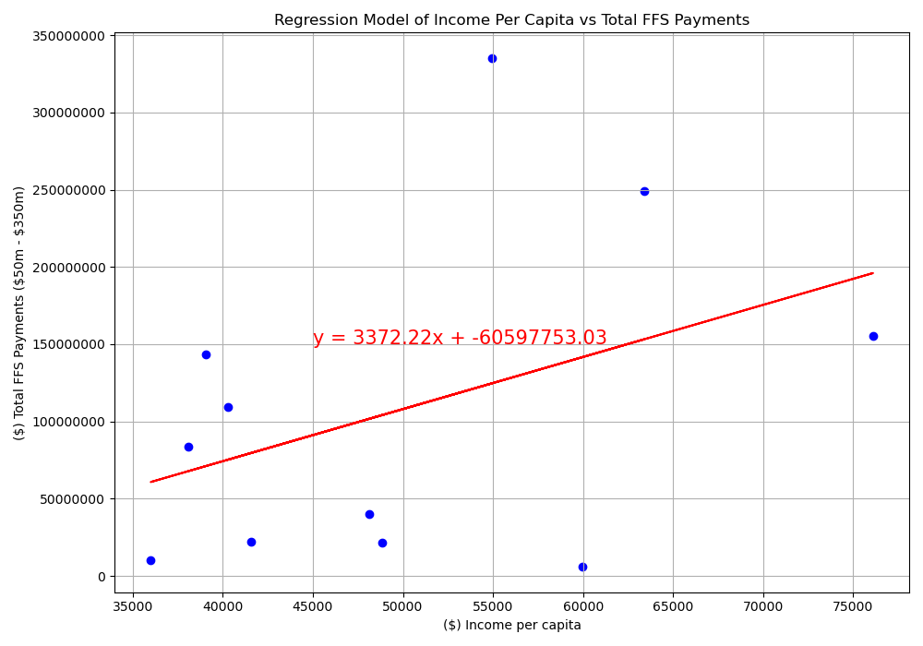
INCOME PER CAPITA VS TOTAL FFS PAYMENTS PER COUNTY
*Positive correlation. Our hypothesis is wrong?
The correlation coefficient is 0.40

Slide 21
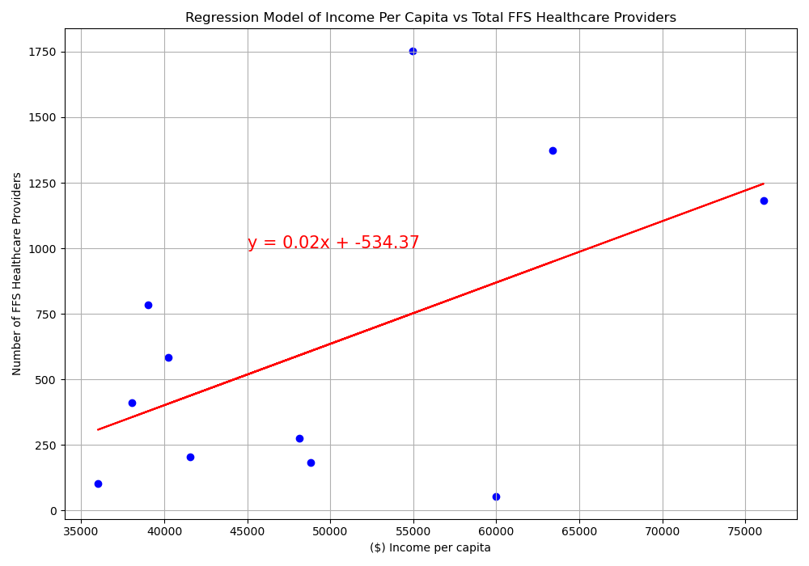
INCOME PER CAPITA VS TOTAL FFS PROVIDERS PER COUNTY
*Similar result when compared to amount of providers!
The correlation coefficient is 0.52

Slide 22
WHAT DOES THIS MEAN?
This means that our hypothesis is wrong and that the amount of FFS payments goes up with income per capita.
For every $1 increase in GDP per capita, there is a 0.02 increase in the number of FFS healthcare providers.
For every $1 increase in GDP per capita, there is a whopping $3372 increase in the amount of FFS payments received. This means that FFS providers may have an incentive to choose areas with higher GDP per capita.
Both had moderately high correlations of .4 and .53 respectively.
BUT this model does not account for population, it may mean that even if a county is relatively poor, they may not have a large enough population to support as many FFS providers…

Slide 23
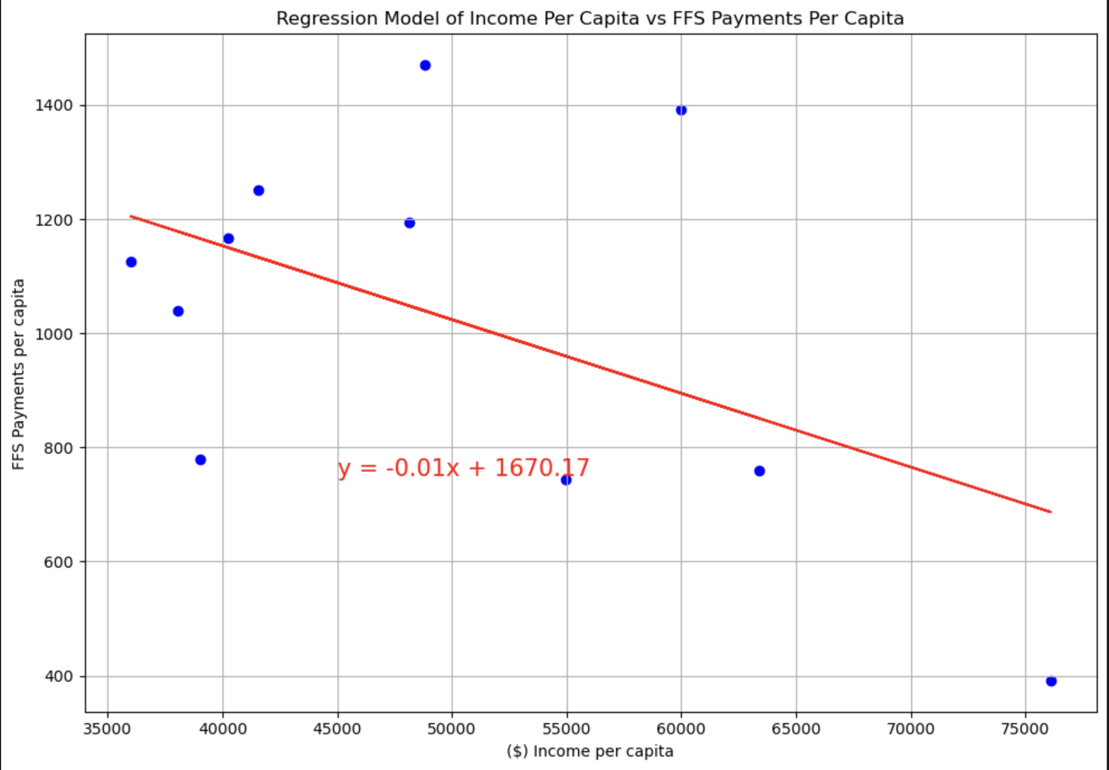
RETRYING REGRESSION: INCOME/CAPITA VS PAYMENTS/CAPITA
When we create a variable that calculates FFS payments per capita, we see a negative correlation! This shows that population it also affects FFS services.
When population is considered, it supports our hypothesis.
As Income per capita increases, FFS Payments per capita decreases. Showing FFS providers may target lower income communities.
The correlation is -0.51

Slide 24

EVEN LOWER P-VALUE!

Slide 25
Conclusion/Further Research Needed
The analysis of total payments showed us that there was a drop in FFS service use in 2018.
Analyzing the types of services showed us that independent diagnostic testing is a top service used.
The income, population, and FFS payment differences between Loudoun and Virginia Beach led us to believe that income does play a large difference in FFS service use.
Our initial Regression Analysis showed us that there is a positive relationship between income per capita and total FFS payments. Which went against our hypothesis.
However, FFS providers and their payments received may be inherently drawn to larger population centers, as our data shows.
When population is considered FFS payments, it gives us a negative correlation, which supports our hypothesis, and we learned how much of an effect population and income have on FFS health service use.
Limitations:
Since we are working with medicare data, FFS services may also be biased towards older population.
Including more counties would give is more information and more accurate regression analysis.

